Slide 1

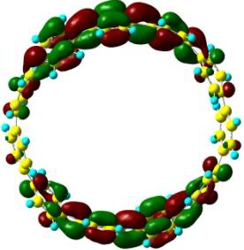
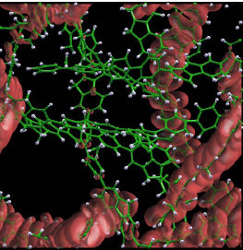
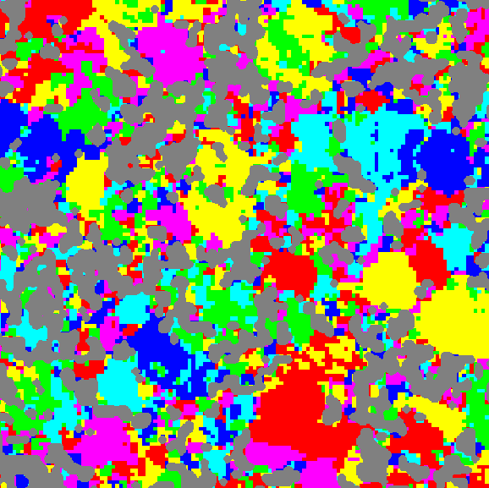
Efficient non-adiabatic excited state dynamics simulations in extended molecular systems
MolSSI workshop The University at Buffalo, Buffalo, June 9, 2018
Sergei Tretiak
Group homepage: http://cnls.lanl.gov/~serg/ tretiak@lanl.gov
Center for Integrated Nanotechnologies (CINT)
Center for Nonlinear Studies (CNLS)
Theoretical Division
1 nm
50 nm
10 nm

Slide 2
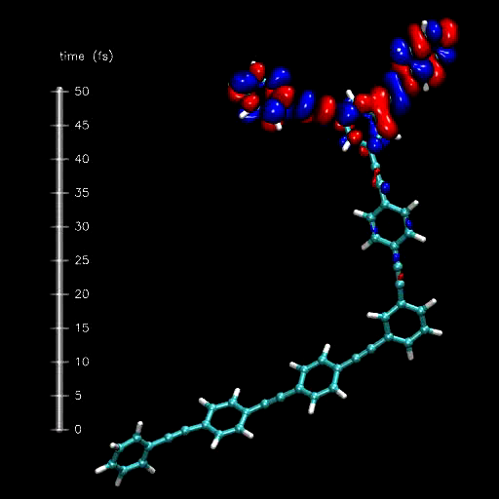
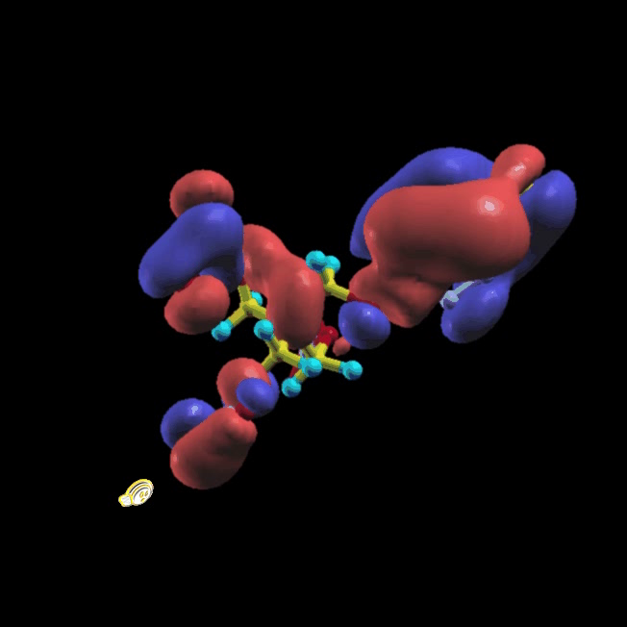
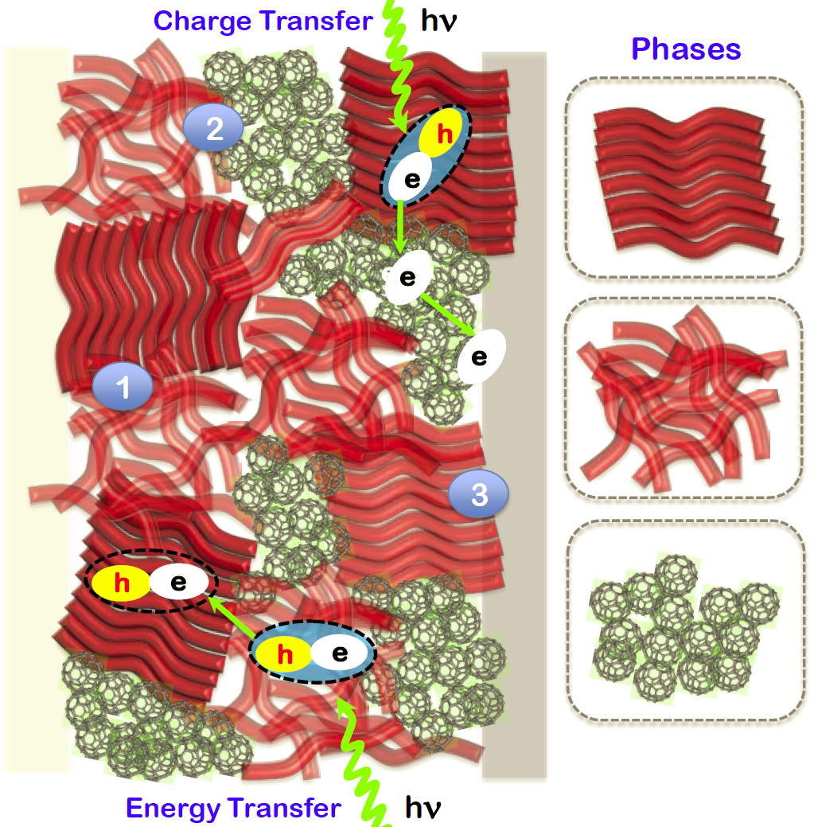

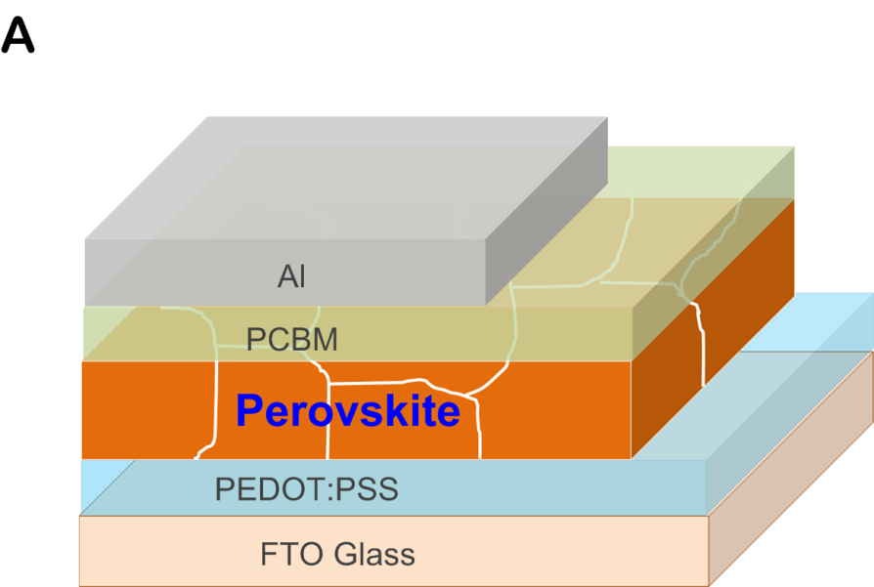
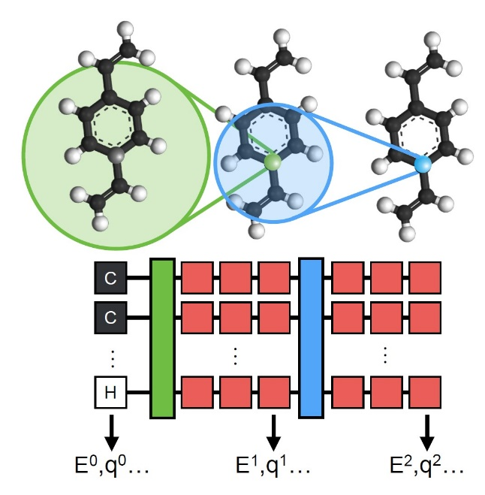
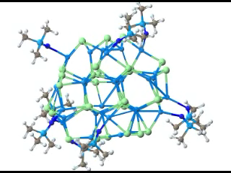
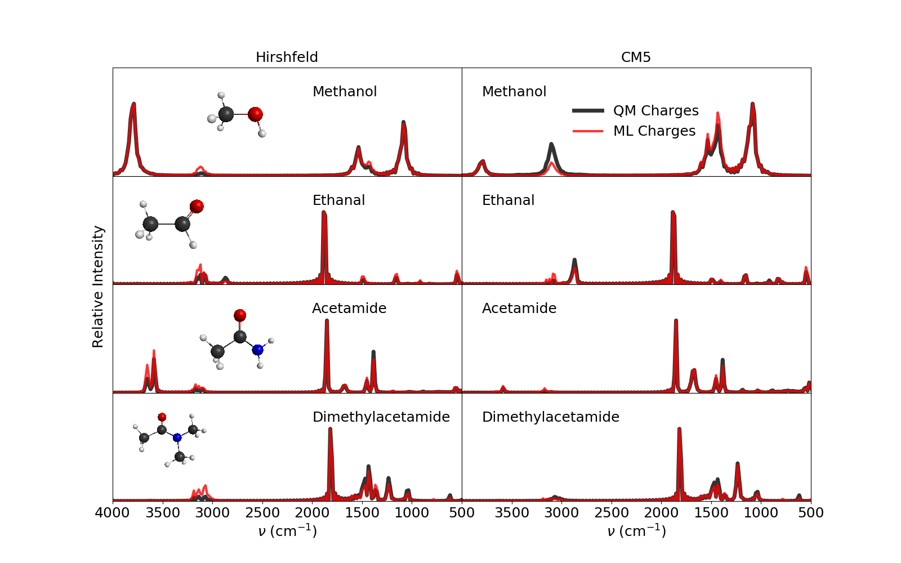
Our research interests
Photoexcited dynamics
Photochemistry
Electronic transport
Carbon nanotubes
Quantum dots
Perovskite
optoelectronics
Machine Learning

Slide 3
Photoinduced dynamics
Excited state relaxation timescales:
Fluorescent decay ~ 1 ns
Intraband relaxation ~ 10 ps
Level crossing ~ 100 fs

Slide 4
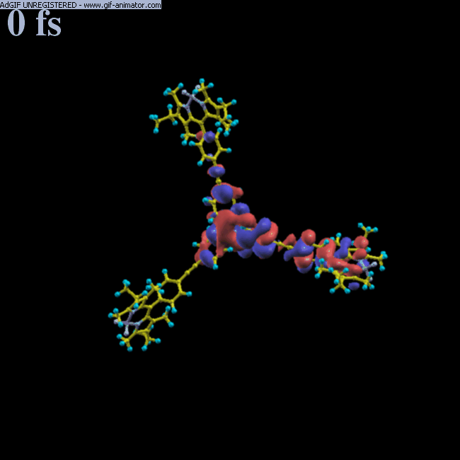
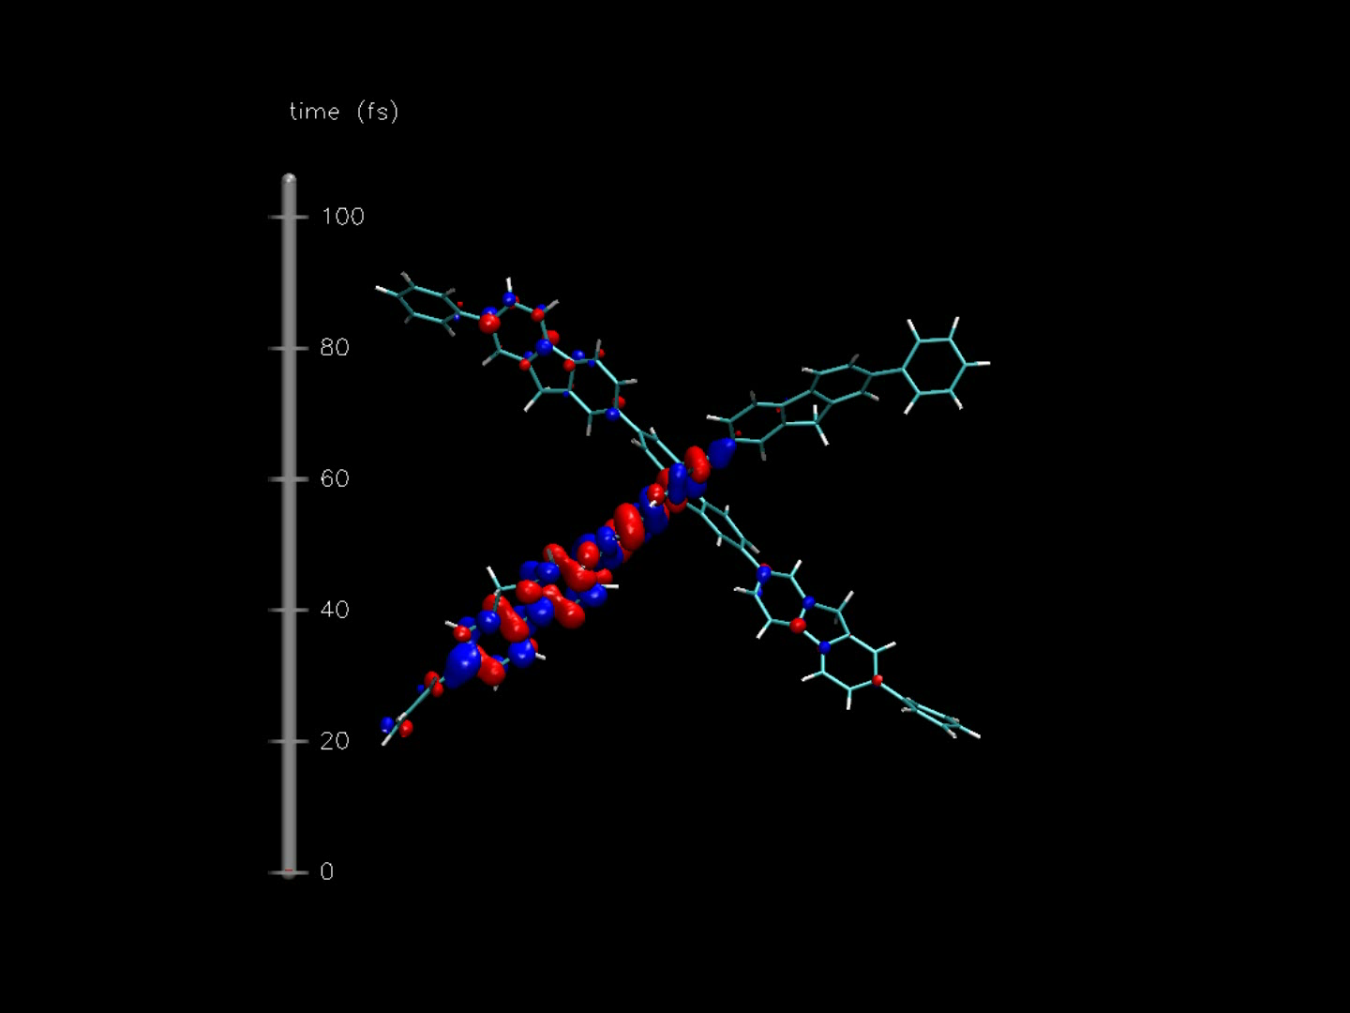
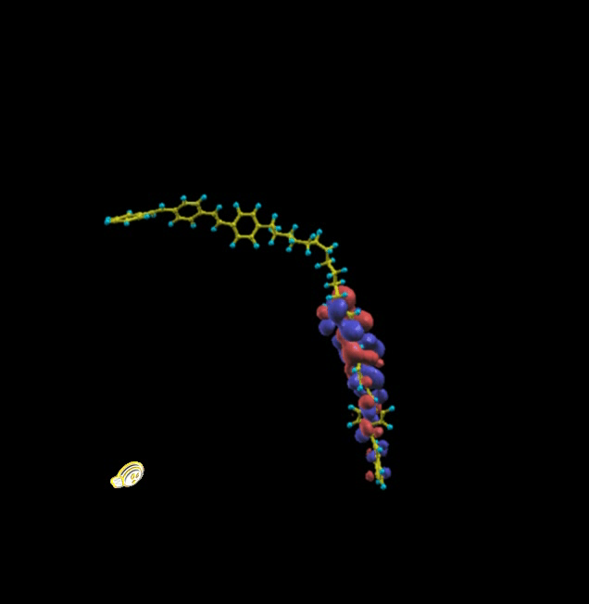
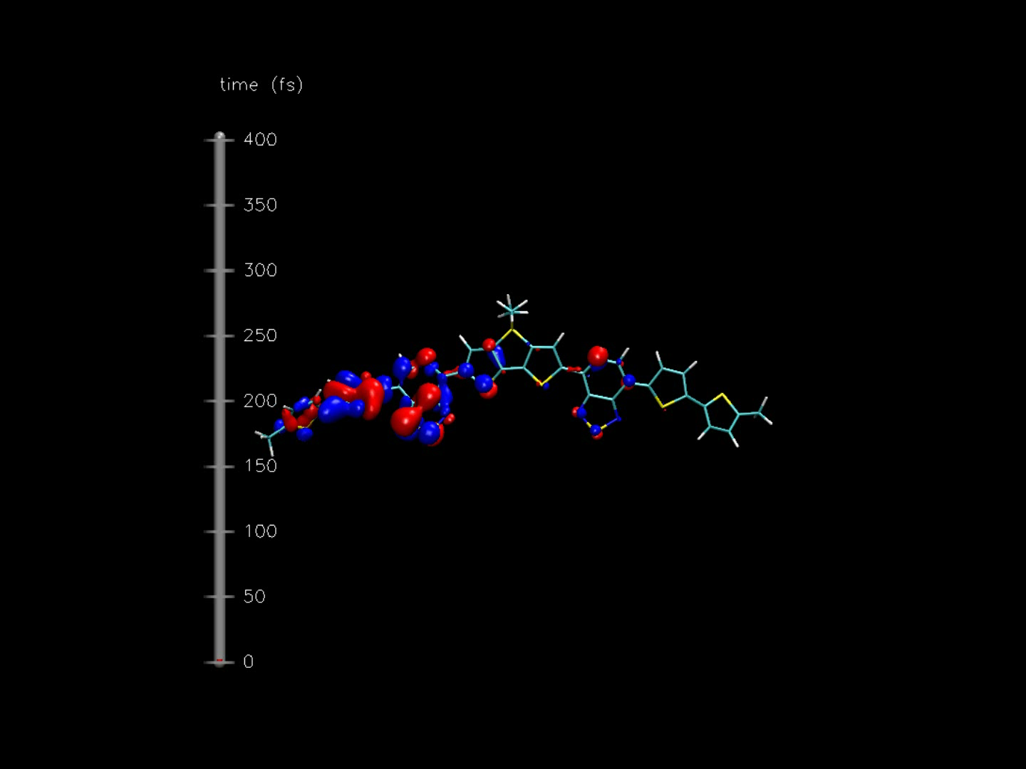
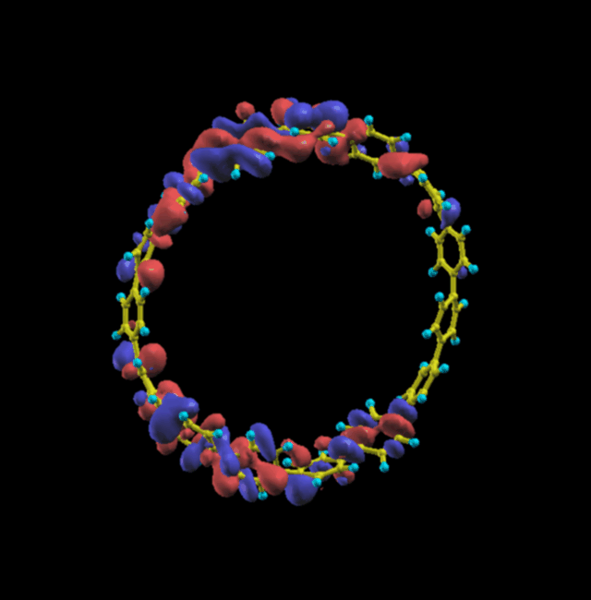

Slide 5
Mixed classical-quantum dynamics

Slide 6
Calculation of forces

Slide 7
Occupation probabilities: Erhenfest
J. Tully, J. Chem. Phys. 93, 1061 (1990)

Slide 8
Electronic surface hopping
J. Tully, J. Chem. Phys. 93, 1061 (1990)

Slide 9
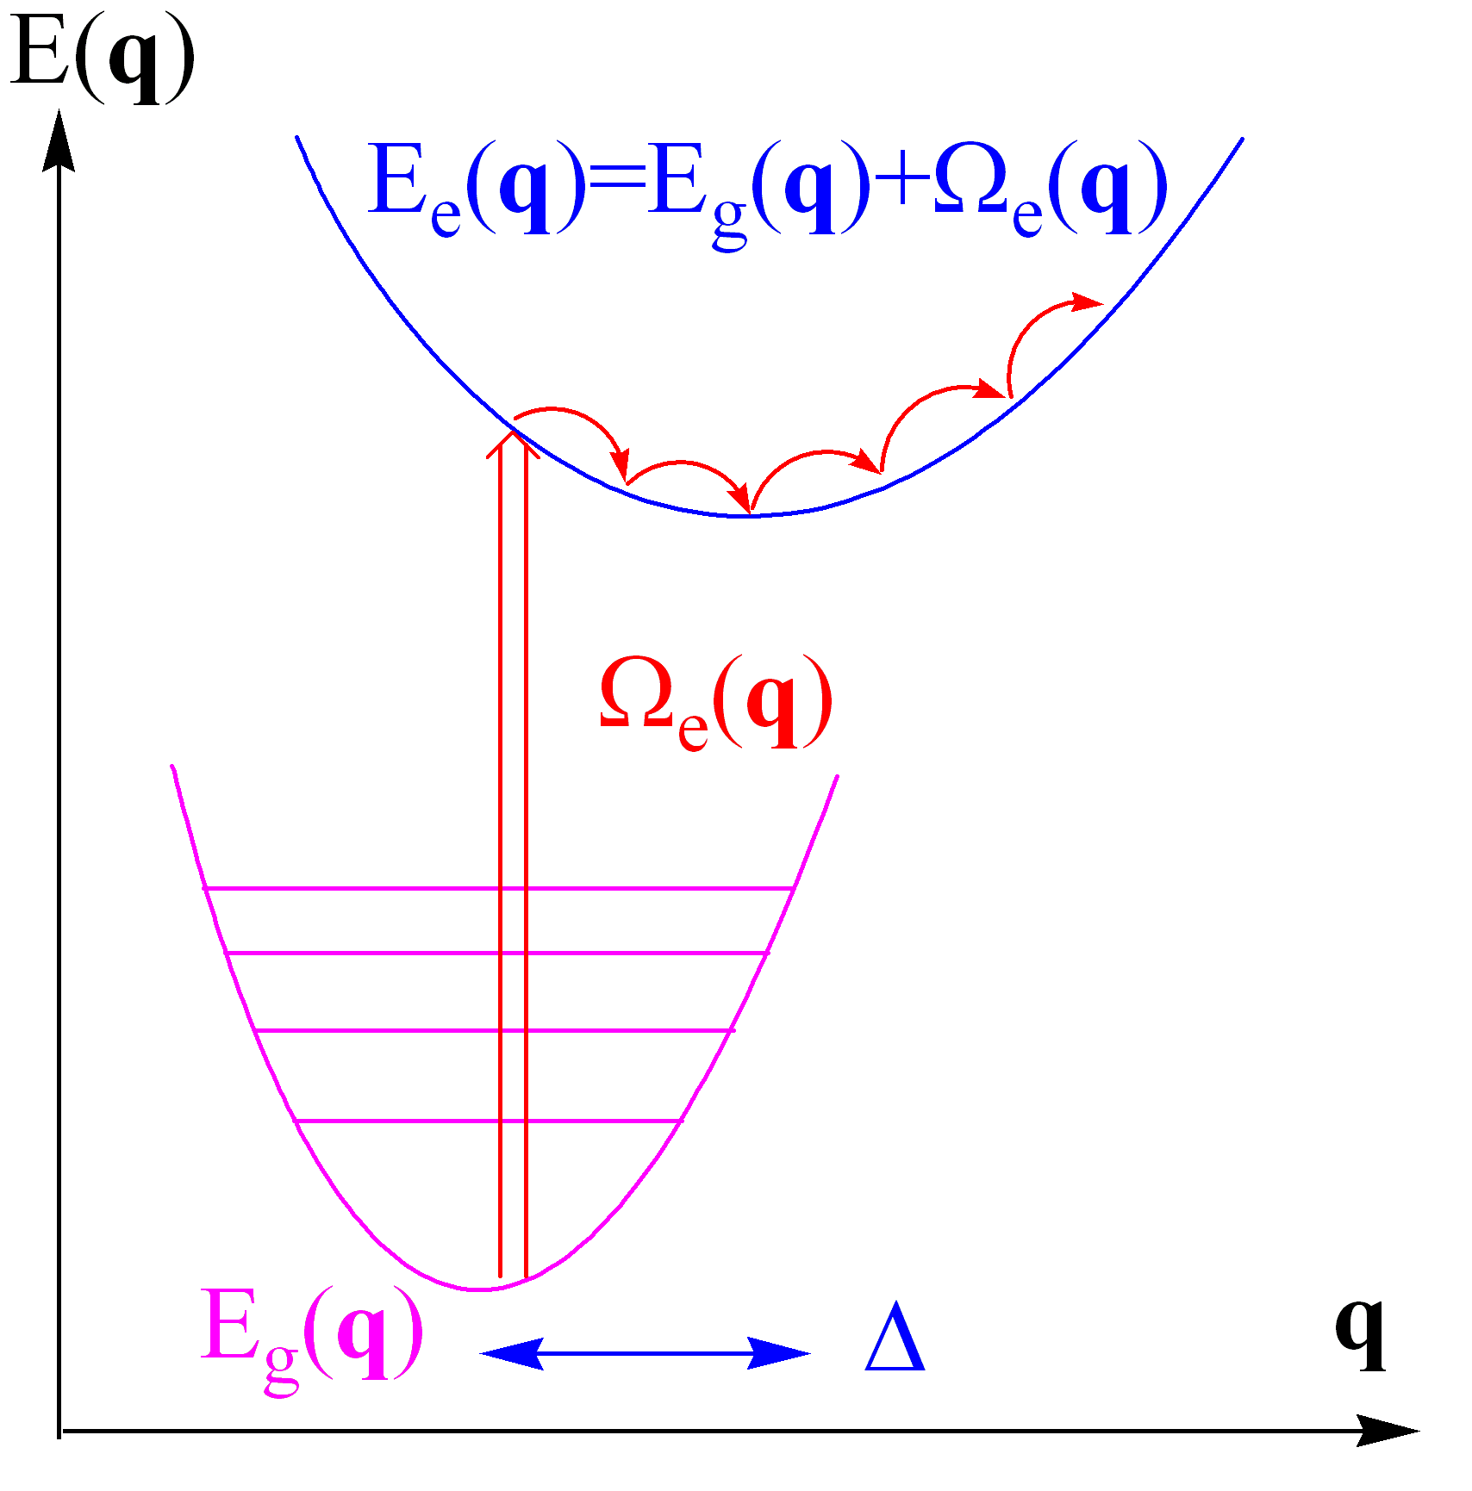
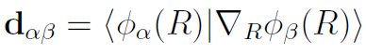
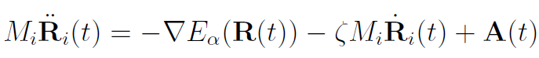
Excited state molecular dynamics
Born-Oppenheimer (mixed Quantum-Classical) Dynamics:
Non-adiabatic dynamics with Quantum Transitions:
Non-adiabatic couplings define transition probability between states
Run ensembles of trajectories (wavepacket) to statistically determine the relaxation rate
Langevin equation of motion for nuclei
Mass, acceleration
Force
Viscosity
Stochastic force
S. Kilina, D. Kilin, and S. Tretiak, Chem. Rev., 115, 5929 (2015); T. Nelson, S.F. Alberti, A. E. Roitberg, S. Tretiak, Acc. Chem. Res., 47, 1155 (2014)
S. Tretiak, A. Saxena, R.L. Martin and A. R. Bishop, Phys. Rev. Lett. 89, 97402 (2002)

Slide 10
The main questions when approaching large molecular systems:
What is an optimal model chemistry in terms of numerical cost/accuracy? The answer is system-specific!!!!
What are the main ‘pitfalls’ for accuracy loss while modeling photoexcited dynamics?
Are we describing excited state properly? Excitons, charge transfer states, spin states, bond-breaking, etc.
Are we using appropriate non-adiabatic excited state dynamics methodology? Branching into products, coherences, etc.
What are we missing in our particular implementation? Reaching statistical averages, uncontrolled approximations, numerical issues (e.g. trivial crossings)

Slide 11
Our current Non-adiabativ Excited state Molecular Dynamics (NEXMD) solution
What the NEXMD does:
Description of electronic system and excited states
Surface hopping on ‘steroids’: implementation, convergence, trivial crossings, coherences, solvation, transition density analysis
Representative applications: Excited state dynamics in organic semiconductors:
Non-adiabatic excited state wavefunction localization in large molecules
Dynamics of excitons on the circle: self-trapping and energy transfer
Interference of interchromophoric energy transfer pathways in macrocycles: the ‘poker game’.

Slide 12
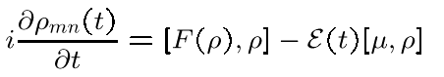
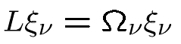
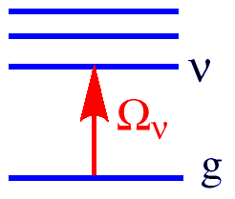
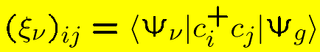
Time-Dependent Density Functional Theory & Time-Dependent Hartree-Fock formalism
TD equation of motion:
Electronic normal modes or transition densities
Krylov space algorithms (e.g. Davidson, Lanczos)
Scaling of computational effort:
Time ~N³
Memory ~N²
Cost/per excited state is smaller than SCF ground state effort
TDHF: Dirac, Pines, Bartlett, Schmitt-Rink, Jorgensen, McKoy, Fukotome ….
TDDFT: Runge, Gross, Casida, Perdew, Becke, Yang, Burke, Furche ….

Slide 13
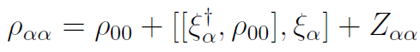
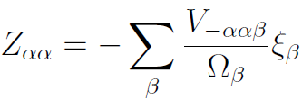
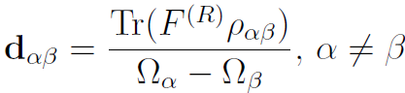
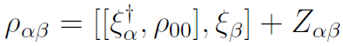
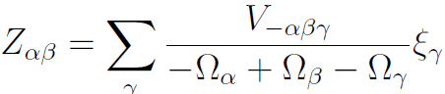
Computing analytic gradients and non-adiabatic couplings:
Analytic gradients for excited state potential energy surfaces (Furche/Ahlrichs)
Need excited state density matrices
10-40%
F. Furche, R. Ahlrichs, J. Chem. Phys. 117, 7433 (2002)
S. Tretiak, V. Chernyak, J. Chem. Phys., 119, 8809(2003); S. Tretiak, S. Mukamel, Chem. Rev., 102, 3171 (2002)
‘Relaxed’ part of excited state density matrices
Analytic calculation of non-adiabatic couplings among excited state (Tommasini/Chernyak/Mukamel/Furche)
M. Tommasini, V. Chernyak, S. Mukamel, Int. J. Quant.Chem., 85, 225 (2001); V. Chernyak, S. Mukamel, J. Chem. Phys., 112, 3572 (2000)
Need transition density matrices between excited states
S. Tretiak, V. Chernyak, S. Mukamel, Int. J. Quant. Chem., 70, 711 (1998), S. Tretiak, V. Chernyak, J. Chem. Phys., 119, 8809(2003).
5-15%

Slide 14
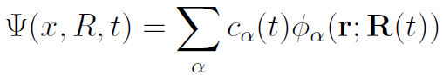
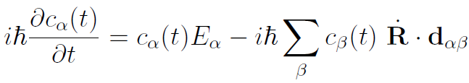
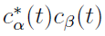
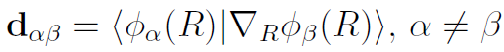
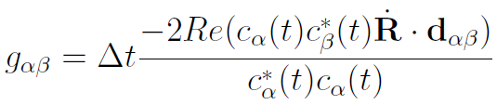
Excited state MD with non-adiabatic Tully’s fewest switches hopping (FSSH)
Langevin equation of motion for nuclei on a single potential energy surface (PES)
Mass, acceleration
Force
Viscosity
Stochastic force
Expansion of wavefunction coefficients in adiabatic many-electron states (TDHF or CIS)
Evolution of time-dependent coefficients from time-dependent Schrodinger equation
Occupation probability of a given adiabatic state
Non-adiabatic couplings
Probability of hopping from one PES to another
J. Tully, J. Chem. Phys. 93, 1061 (1990)

Slide 15
What RPA framework can do…
Pros:
Numerically efficient (states, gradients, couplings)
Can describe excitons
Can describe crossings of excited states
Transparent physics of semiempirics
Cons:
Beware of semiempirics, semi-quantitative accuracy
Cannot describe excited/ground state crossings
Cannot describe double excitations and generally highly correlated states
Problems with energetics of spin states
Problems with open shell and bond braking

Slide 16
Overcoming the numerical expense:
10 ps excited state dynamics;
0.05 fs time-step for electronic dynamics
500 trajectories
10⁹ calculations of excited states
Software package
Based on SQM (Amber Tools)
Efficient semiempirical calculations of the excited states at TDHF or CIS level (Krylov space algorithms);
Analytic gradients for excited state potential energy surfaces (Furche/Ahlrichs);
Analytic calculation of non-adiabatic couplings among excited state (Tommasini/Chernyak/Mukamel/Furche);
Various types of the excited state MD (Langevin, Anderson thermostats, energy conserving dynamics, etc.);
Optimal combination of 2 propagators (velocity Verlet for nuclear and Runge-Kutta for electronic dynamics)
T. Nelson, S. Fernandez-Alberti, V. Chernyak, A.E. Roitberg, S. Tretiak, J. Phys. Chem. B 115, 5402 (2011); T. Nelson, S.F. Alberti, A. E. Roitberg, S. Tretiak, Acc. Chem. Res., 47, 1155 (2014)
NEXMD allows calculations ~1000 atoms molecules and ~10ps timescales

Slide 17
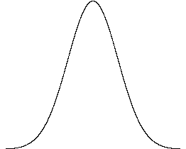
Taking snapshots for excited state dynamics
Spiro-fluorene oligomer
t
Excitation wavepacket for an ensemble of (~500) trajectories
Absorption spectrum
T. Nelson, S. Fernandez-Alberti, V. Chernyak, A.E. Roitberg, S. Tretiak, J. Phys. Chem. B 115, 5402 (2011); Nelson, S.F. Alberti, A. E. Roitberg, S. Tretiak, Acc. Chem. Res., 47, 1155 (2014)

Slide 18
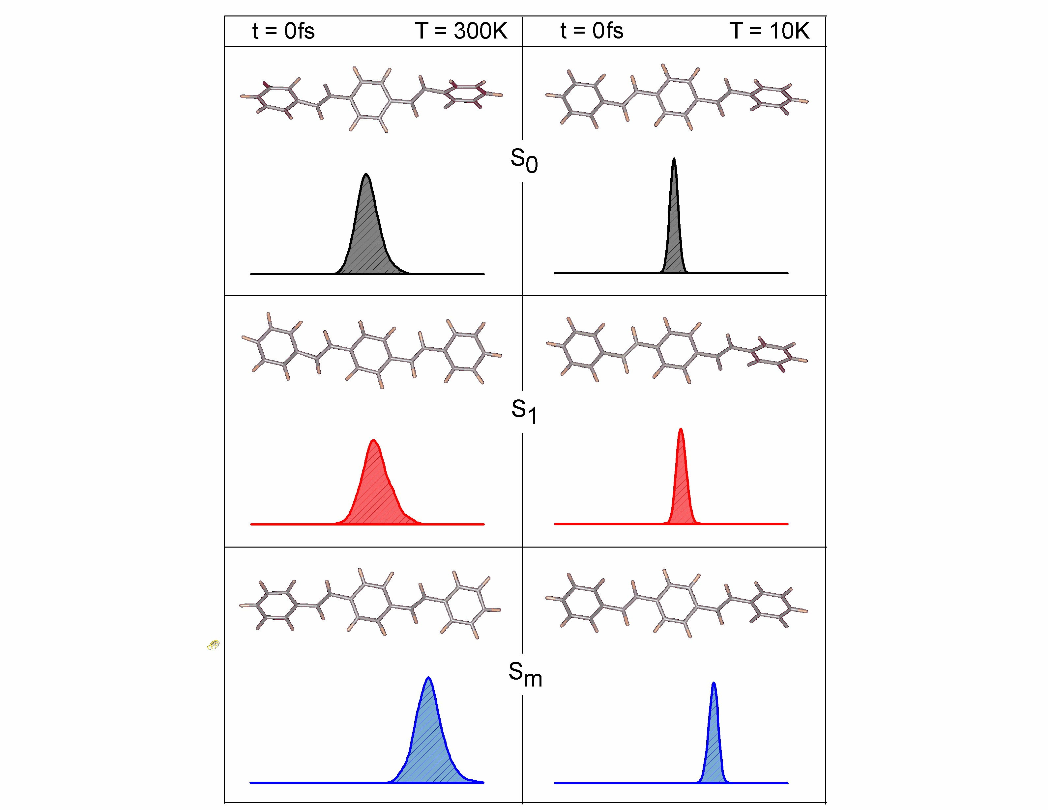
Wavepacket Evolution
energy
Notes:
Add x-axis label “energy”
You can see the vibrational relaxation better at 10K because hopping is slower and wavepacket is less broad. Can see that Sm trajectory goes over two gaps. Look at S1 molecule is more planar compared to GS where the molecule is twisty.

Slide 19
Our NEXMD solution
What the NEXMD does:
Description of electronic system and excited states
Surface hopping on ‘steroids’: implementation, convergence, trivial crossings, coherences, solvation, transition density analysis
Representative applications: Excited state dynamics in organic semiconductors:
Non-adiabatic excited state wavefunction localization in large molecules
Dynamics of excitons on the circle: self-trapping and energy transfer
Interference of interchromophoric energy transfer pathways in macrocycles: the ‘poker game’.

Slide 20
Where are we going?
Environmental effects:
State-specific and Non-equilibrium solvation
Quantum Mechanics/Molecular Mechanics (QM/MM)
Extended Largangian excited state MD
Open shell, bond breaking, intersystem crossings
Hamiltonian on demand via Machine Learning including both semiempirics and DFTB
Better non-adiabatic algorithms
Coupled Wavefunctions Non-Adiabatic Molecular Dynamics (CW-NAMD)

Slide 21
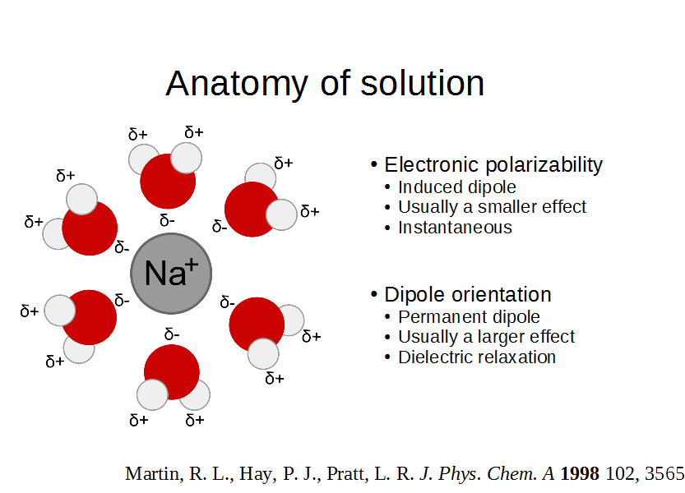

Slide 22
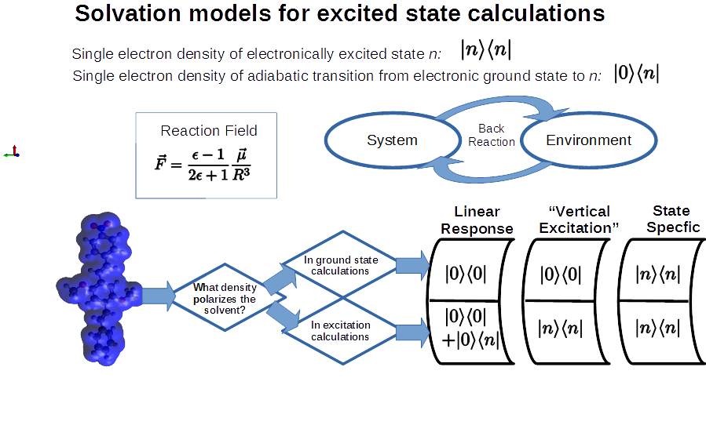
Solvation models for excited state calculations
Analytic gradients
J. A. Bjorgaard, V. Kuzmenko, K. Velizhanin, S. Tretiak, J. Chem. Phys. 142, 044103. (2015) J. A. Bjorgaard, K. Velizhanin, S. Tretiak, J. Chem. Phys. 143, 054305 (2015) C. A. Guido, G. Scalmani, B. Mennucci, D. Jacquemin, J. Chem. Phys. 146, 204106 (2017)

Slide 23
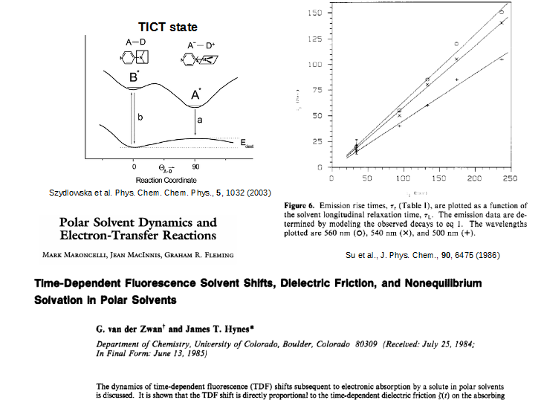
Non-equilibrium solvation: measurable

Slide 24
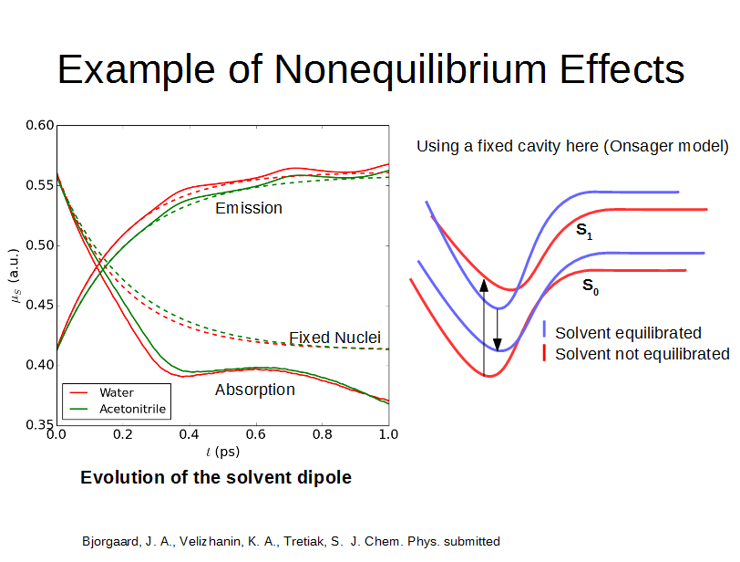
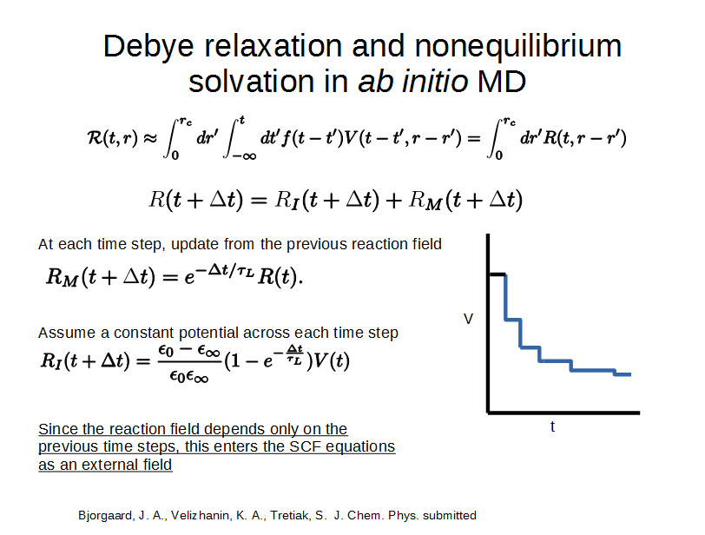
Non-equilibrium solvation in NEXMD
J. A. Bjorgaard, K. Velizhanin, S. Tretiak, J. Chem. Phys. 144, 154104 (2016)

Slide 25
LR solvent non-adiabatic dynamics
A. E. Sifain, J. A. Bjorgaard, T.R. Nelson, B.T. Nebgen, A.J. White, B. J. Gifford, O.V. Prezhdo, S. Fernandez-Alberti, A.E. Roitberg, S. Tretiak (2018, submitted)

Slide 26
QM/MM framework
QM/MM interactions
MM effect on QM: van-der-Waals spheres and polarization/charges;
QM effect on MM: polarization through the excited state density matrix ρ^{ex}_{ij}
Note that ρgr_{ij} is used in the ground state QM/MM dynamics (e.g., AMBER Tools/AMBER).
So conceptually excited state QM/MM is straightforward and attractive.

Slide 27
Where are we going?
Environmental effects:
State-specific and Non-equilibrium solvation
Quantum Mechanics/Molecular Mechanics (QM/MM)
Extended Largangian excited state MD
Open shell, bond breaking, intersystem crossings
Hamiltonian on demand via Machine Learning including both semiempirics and DFTB
Better non-adiabatic algorithms
Coupled Wavefunctions Non-Adiabatic Molecular Dynamics (CW-NAMD)

Slide 28
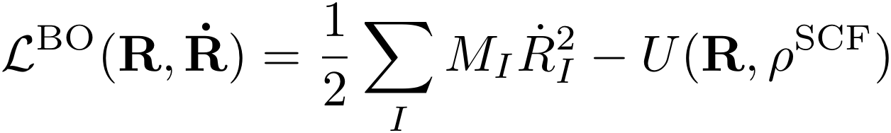
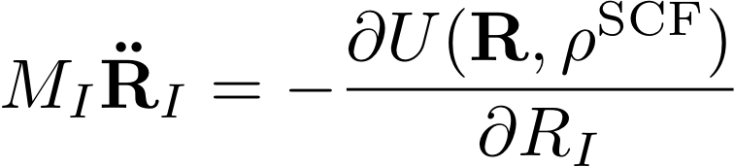
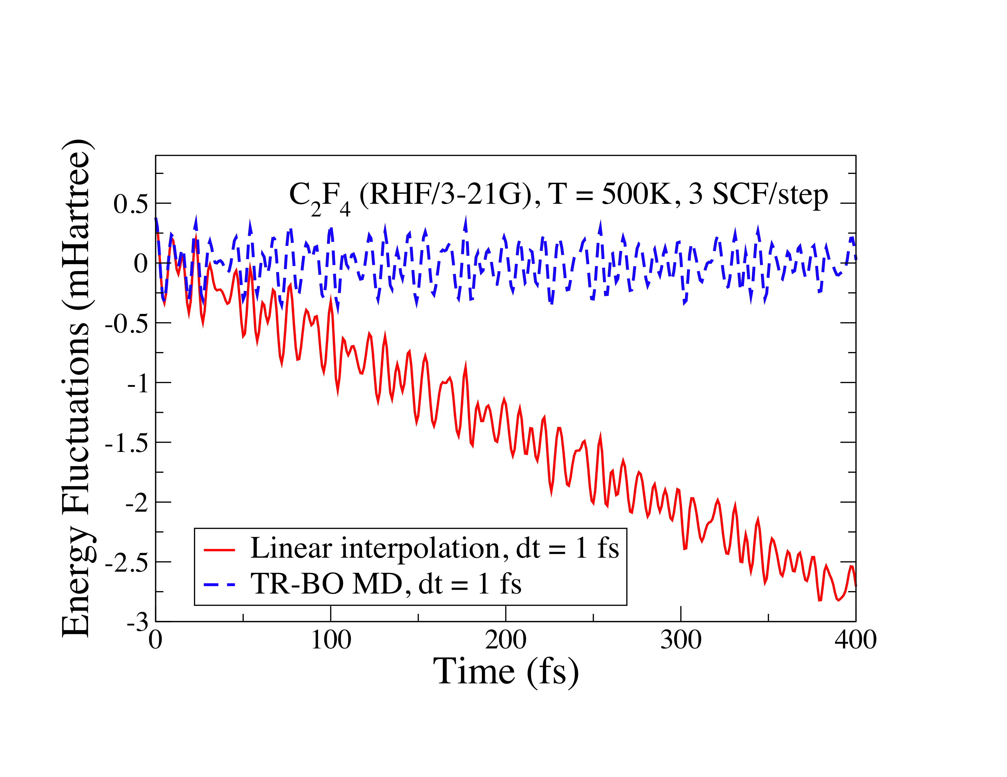
Problems with ab initio BOMD
Broken time-reversibility
Unstable trajectories with energy drift
Impose time-reversibility
or use “exact” forces?
The next generation QMD allows both without the iterative SCF optimization!

Slide 29
Extended Lagrangian excited states
The Euler−Lagrange equations
Ground state density matrix P is an extended dynamical variable to the Born-Oppenheimer Lagrangian that follows the ground state through a harmonic oscillator centered around the evolving ground state D. ζ is the corresponding variable to the excited state transition density ξ
μ_{gs} , μ_{es} , ω_{gs} and ω_{es} are the ficticious electronic mass and frequency parameters of the extended harmonic oscillators for the ground state (gs) and the excited state (es).
J. A. Bjorgaard, D. Sheppard, S. Tretiak, A. Nicklasson, J. Comp. Theor. Chem. (2018, ASAP)

Slide 30
Extended Lagrangian excited states
Vanishing mass -> decoupled Euler−Lagrange equations
A modified Verlet integration scheme with small amount of dissipation
P(t+δt) and ζ(t+dt) provide accurate approximations to D(t+δt) and ξ(t+δt) up to δt²
J. A. Bjorgaard, D. Sheppard, S. Tretiak, A. Nicklasson, J. Comp. Theor. Chem. (2018, ASAP)

Slide 31
XL-ESMD adiabatic dynamics tests
Long story short: N_{SCF}=2 and d_{ES}=10⁻⁴ eV work well vs general non-XL d_{SCF}=10⁻⁸ eV and d_{ES}=10⁻⁷ eV
J. A. Bjorgaard, D. Sheppard, S. Tretiak, A. Nicklasson, J. Comp. Theor. Chem. (2018, ASAP)

Slide 32
Where are we going?
Environmental effects:
State-specific and Non-equilibrium solvation
Quantum Mechanics/Molecular Mechanics (QM/MM)
Extended Largangian excited state MD
Open shell, bond breaking, intersystem crossings
Hamiltonian on demand via Machine Learning including both semiempirics and DFTB
Better non-adiabatic algorithms
Coupled Wavefunctions Non-Adiabatic Molecular Dynamics (CW-NAMD)

Slide 33
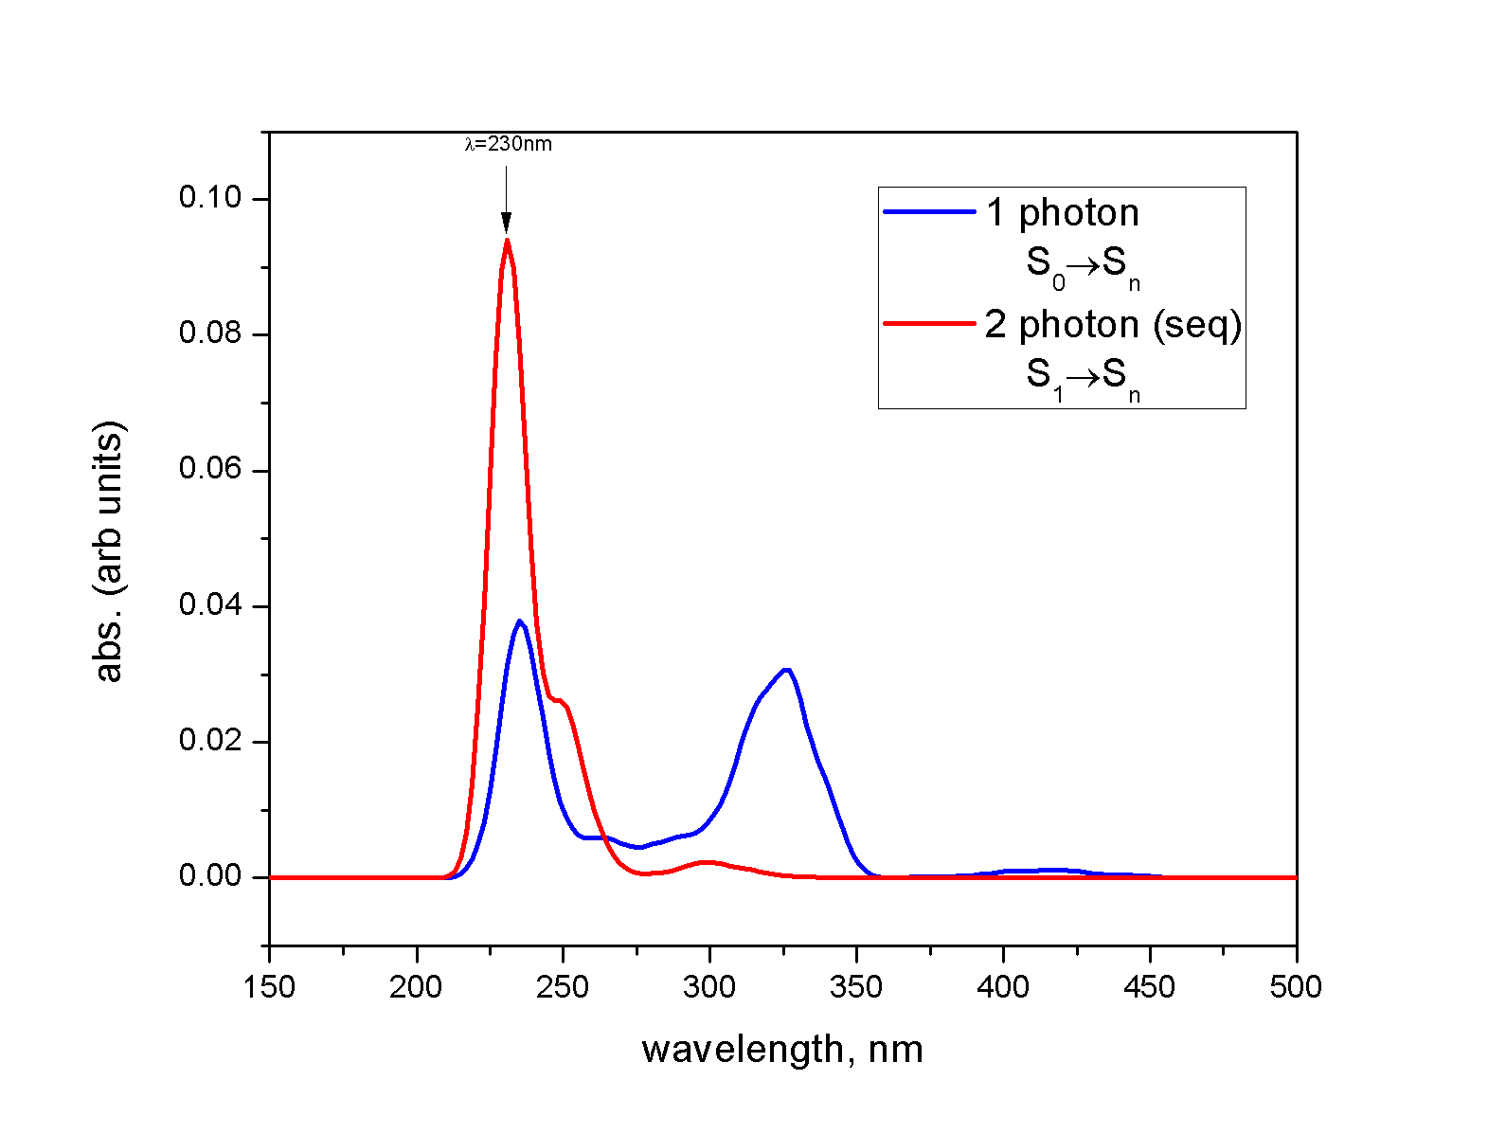
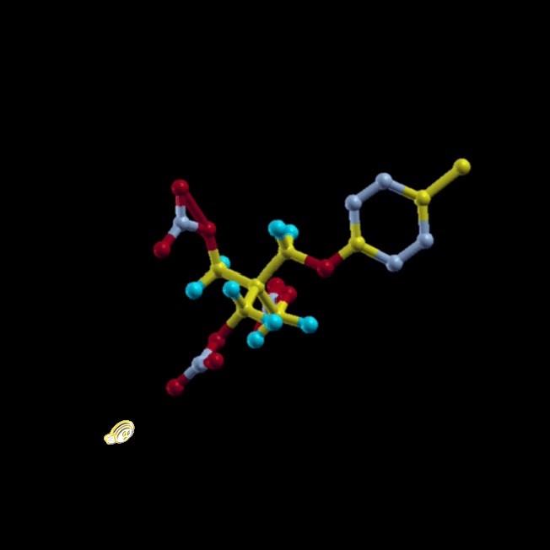
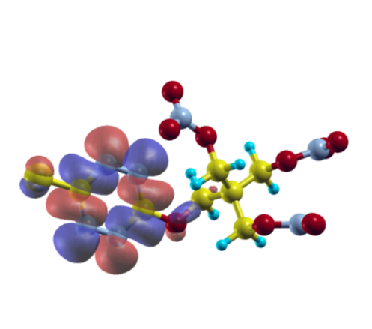
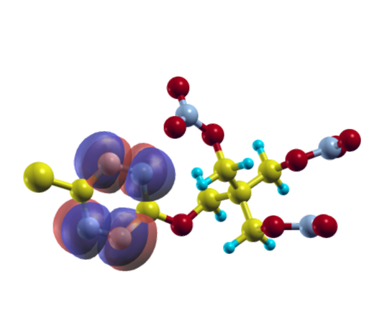
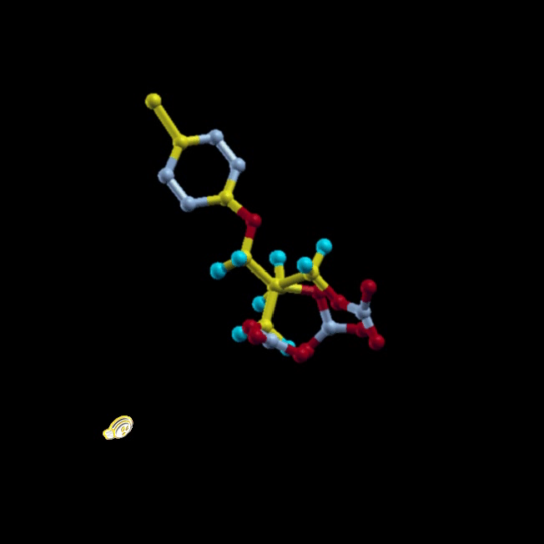
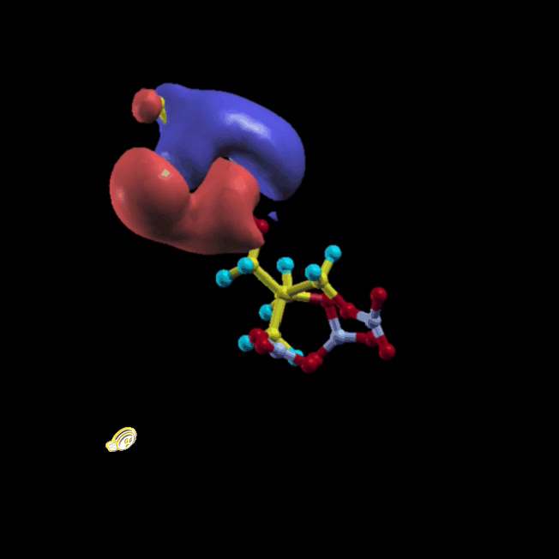
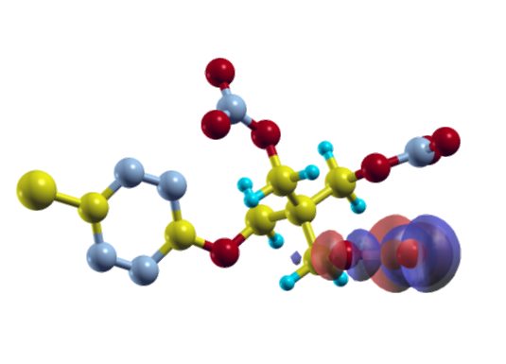
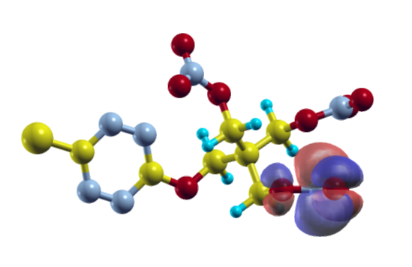


Functionalized Tetrazine-Cl
NO₂ Dissociation
Energy transfer from tetrazine to NO₂
 | HOMO | LUMO
S₁ (420nm)
S₅ (275nm) NO₂ dark states
S₂₉ (230nm) Initial state
Tetrazine photochemistry
No energy transfer
M.T. Greenfield, S.D. McGrane, C.A, Bolme, J.A. Bjorgaard, T.R. Nelson, S. Tretiak, R.J. Scharff, J. Phys. Chem. C, 119, 4846 { 4855 (2015)

Slide 34

Open shell implementation is needed

Slide 35
Where are we going?
Environmental effects:
State-specific and Non-equilibrium solvation
Quantum Mechanics/Molecular Mechanics (QM/MM)
Extended Largangian excited state MD
Open shell, bond breaking, intersystem crossings
Hamiltonian on demand via Machine Learning including both semiempirics and DFTB
Better non-adiabatic algorithms
Coupled Wavefunctions Non-Adiabatic Molecular Dynamics (CW-NAMD)

Slide 36


Machine Learning – advanced optimization
http://numb3r3.com/2017/11/02/intro-dnn.html

Slide 37

Concept of Machine Learning (ML) Applied to Chemistry
Example: success story molecular energies Chemical Science, 8, 3192 (2017)
Use ML techniques to construct optimized effective Hamiltonians for molecular properties.
ML for ab initio-derived force fields is widely successful

Slide 38

Example ML force field dynamics
DFT reference:
wB97x/6-31G*
ANI-1 ML force field
arXiv:1710.00017, 2017
Curtesy Justin Smith
Carbon nanoparticles/sheets nucleation [4000 atoms in 60Å box at 2500K] 5ns MD simulation

Slide 39


Structure of HipNN Neural Network
Typically results in ~10,000 different parameters.
Steepest gradient descent algorithms optimize 𝑊, 𝑉, 𝑠
Atomic Layer

Slide 40


Charge and bond order prediction
ML generated IR spectrum.
For each molecule a 100 ps MD trajectory was performed with ML ANI-1 forces.
HIP-NN was used to generate Hirshfeld charges for each molecule at each point.
At each point a DFT calculation was performed for charges for comparison

Slide 41
Where are we going?
Environmental effects:
State-specific and Non-equilibrium solvation
Quantum Mechanics/Molecular Mechanics (QM/MM)
Extended Largangian excited state MD
Open shell, bond breaking, intersystem crossings
Hamiltonian on demand via Machine Learning including both semiempirics and DFTB
Better non-adiabatic algorithms
Coupled Wavefunctions Non-Adiabatic Molecular Dynamics (CW-NAMD)

Slide 42

Convergence of accelerated methods
Ehrenfest (mean field) uses 1-2 trajectories;
Standard surface hopping converges at ~1,000 trajectories;
Monte-Carlo converges at ~50,000 trajectories
CW-NAMD convergence is achieved at ~1-100 trajectories, depending on non-adiabaticity strength, interfering pathways, etc.
CW-NAMD convergence is controlled by a single numetical parameter O_{min}
A.J. White, V.N. Gorshkov, R. Wang, S. Tretiak, D. Mozyrsky J. Chem. Phys., 143, 014115 (2015) A.J. White, S. Tretiak, D. Mozyrsky, Chem. Sci. 7, 4905 (2016)

Slide 43







Acknowledgments
Code and applications
NEXMD
Tammie Nelson (LANL)
Ludmila Adamska (LANL)
Andrew Sifain (LANL)
Team: Adrian Roitberg (U. Florida)
Team: Sebastian Fernandez-Alberti
(U. Nacional de Quilmes, Argentina)
Theory:
Solvent, XL-ESMD
Josiah Bjorgaard (LANL)
Anders Nicklasson (LANL)
CW-NAMD
Alex White (LANL)
Dima Mozyrsky (LANL)
ML
Ben Nebgen (LANL)
Kipton Barros (LANL)
Group homepage: http://cnls.lanl.gov/~serg tretiak@lanl.gov
Center for Integrated Nanotechnologies (CINT)
Center for Nonlinear Studies (CNLS)
LDRD program at LANL, DOE BES, EFRC

Slide 44




Center for Integrated Nanotechnologies (CINT) DOE USER FACILITY
One of 5 national nanoscience user facilities operated jointly by LANL and SNL;
Extensive experimental and modeling capabilities organized into four Science Thrusts:
Nanoscale Electronics & Mechanics,
Nanophotonics & Optical Nanomaterials,
Soft, Biological & Composite Nanomaterials,
Theory & Simulation of Nanoscale Phenomena;
Access is via peer-reviewed proposals, for independent or collaborative research, semi-annual Calls for User Proposals or Rapid Access.
http://cint.lanl.gov/
Join our USERs!

Slide 45



LANL Postdoc and Student Programs
LANL currently employs on average 350 postdocs and over 400 students
A variety of postdoc appointments:
Distinguished Fellows (Oppenheimer, Feynman, Curie)
Director’s Fellows
Research Associates
Appointments for grad and undergrad students
Usually both US citizen and foreign national applicants are welcome
Participate in ongoing broad LANL science and engineering programs
Opportunities for further LANL employment
More information:
Browse http://www.lanl.gov/careers/
Contact directly LANL Staff Scientists
Contact Sergei Tretiak, tretiak@lanl.gov

Slide 46







9th Conference on Excited State Processes in Electronic and Bio Nanomaterials ESP2018
When: June 4-7, 2018
Where: Santa Fe, NM, US
Excited State Processes timeline
Notes:
Optical Probes conference series started some 20 years ago – yes it is our anniversary meeting. I wonder how many people in this room has participated in the very first meeting – please raise the hand! Valy Vardeny was a founding organizer. We had 8 meetings so far. After migrating a bit in the US from Snowbird to Salt Lake to San Diego and back to Salt Lake, the meeting moved abroad big time! It visited Venice, Turku in Finland, Bangalore and Beijing. Finally here we are back to the US. Traditionally the OP meetings focused on the Optical properties of semiconducting polymers and related materials. The Excited State meeting was born here at Los Alamos and always stayed nearby appearing every second year. The focus of excited states is of cause excited states of any nanoscale materials. Let me introduce you Duncan McBranch, Deputy Principle Associate Director, Science, Technology & Engineering. In the previous life Duncan has spent many years working in the field of conjugated organics. At Los Alamos, the cornerstone of fundamental science is LDRD program. The LDRD has been a major supporter of this conference. Let me introduce you Bill Piedhorsky who currently leads LDRD. Finally, this meeting has been organized as a pert of the conference program at the Center for Nonlinear Studies. Bob Ecke, the CNLS director will say a few words.

Slide 47
Thank you!

Slide 48

Acknowledgements Pajarito ski resort

Slide 49

Passing the ball…

Slide 50
Coherent exciton-vibrational dynamics
J. F. Galindo, E. Atas, A. Altan, D. G. Kuroda, S. Fernandez-Alberti, S. Tretiak, V. Kleiman, A. E. Roitberg, J. Am. Chem. Soc., 137, 11637 (2015)
T. Nelson, S. Fernandez-Alberti, A. Roitberg and S. Tretiak, J. Phys. Chem. Lett. (Perspective), 8, 3020 (2017)
T. Nelson, D. Ondarse-Alvarez, N. Oldani, B. Rodriguez-Hernandez, L. Alfonso-Hernandez, J.F. Galindo, V. D. Kleiman, S. Fernandez-Alberti, A. E. Roitberg, S. Tretiak Nature Comm. (2018, in press)

Slide 51

How many trajectories are enough?
T. Nelson, S. Fernandez-Alberti, V. Chernyak, A.E. Roitberg, S. Tretiak, J. Chem. Phys., 136 054108 (2012)
Notes:
Add x-axis label “energy”
You can see the vibrational relaxation better at 10K because hopping is slower and wavepacket is less broad. Can see that Sm trajectory goes over two gaps. Look at S1 molecule is more planar compared to GS where the molecule is twisty.

Slide 52



Approximations to non-adiabatic coupling terms
MODEL | # of coupling terms N_{C}
Complete Coupling (CC)
Partial Coupling (PC)
Two-State (TS)
T. Nelson, S. Fernandez-Alberti, V. Chernyak, A.E. Roitberg, S. Tretiak, J. Chem. Phys., 136 054108 (2012)
Pittner, J. et al. Chemical Physics, 2009, 356, 147–152.

Slide 53

Approximations to non-adiabatic coupling terms
N_{S}=15 Excited States
MODEL | # of coupling terms N_{C}
Complete Coupling (CC)
Partial Coupling (PC)
Two-State (TS)
Complete Coupling model must be used for large numbers of excited states.
Do not cut corners!
Quantum propagation
T. Nelson, S. Fernandez-Alberti, V. Chernyak, A.E. Roitberg, S. Tretiak, J. Chem. Phys., 136 054108 (2012)

Slide 54


Trivial unavoided crossings (following the ‘diabatic pathway’)
Black
Gray
Tully’s FSSH method for crossing of ‘coupled’ states (conical intersections, weakly and strongly avoided crossings);
Min-Sum algorithm for crossing of ‘uncoupled’ states (‘trivial’ unavoided crossings).
S. Fernandez-Alberti, A.E. Roitberg, T. Nelson, S. Tretiak, J. Chem. Phys. 137, 014512 (2012)

Slide 55

Histogram of the overlaps for ‘trivial’ unavoided (hop) and avoided (cross) crossings
S. Fernandez-Alberti, A.E. Roitberg, T. Nelson, S. Tretiak, J. Chem. Phys. 137, 014512 (2012)

Slide 56
Excited state PES effects: Classical Path Approximation (???)
Use ground state PES
Use true excited state PES
4 fs and 63 fs bi-exponential fit
Excited state vibrational relaxation brings states closer facilitating hops;
Excited state trajectories lead to/away from the level crossing regions
380 fs exponential fit

Slide 57
Failure of FSSH and Ehrenfest to describe coherences and interferences
Probability
TL
Initial Momentum
TU
Probability
RL
Initial Momentum
Initial Momentum

Slide 58

Lack of electronic decoherence -> internal inconsistency of FSSH
Pristine FSSH (quantum wavepacket is left ‘behind’
Empirical fix: Instantaneous decoherence schemes
Empirical fix: Energy-based decoherence schemes (Granucci, Truhlar)
T. Nelson, S. Fernandez-Alberti, A. E. Roitberg, S. Tretiak ,J. Chem. Phys., 138 224111 (2013)

Slide 59





Energy-based decoherence schemes are paremeter-dependent
T. Nelson, S. Fernandez-Alberti, A. E. Roitberg, S. Tretiak ,J. Chem. Phys., 138 224111 (2013)

Slide 60


IDC-A (instantaneous decoherence at each attempted hop) is a temporary fix
T. Nelson, S. Fernandez-Alberti, A. E. Roitberg, S. Tretiak ,J. Chem. Phys., 138 224111 (2013)

Slide 61
On-the-fly limiting of essential excited states
Potential computational saving, factor 2-100, depending on the excited state density
T. Nelson, A. Naumov, S. Fernandez-Alberti, S. Tretiak, Chem. Phys., 84-90 (2016)

Slide 62
Part 1: Our NEXMD solution
What the NEXMD does:
Description of electronic system and excited states
Surface hopping on ‘steroids’: implementation, convergence, trivial crossings, coherences, solvation, transition density analysis
Representative applications: Excited state dynamics in organic semiconductors:
Non-adiabatic excited state wavefunction localization in large molecules
Dynamics of excitons on the circle: self-trapping and energy transfer
Interference of interchromophoric energy transfer pathways in macrocycles: the ‘poker game’.

Slide 63

State-specific vibrations: excited state instantaneous normal modes (INMs)
There is only ONE high frequency (~3700cm⁻¹) INM on S_{i+1} (donor) state in the direction of the non-adiabatic coupling vector d_{i+1,i};
This effective coordinate correspond to multiple INMs on S_{i} (acceptor) state – vibrational energy effectively dissipates.
M.A. Soler, A.E. Roitberg, T. Nelson, S. Tretiak, S. Fernandez-Alberti J. Phys. Chem. A, 116, 9802 (2012)

Slide 64
What about excited state equilibrium normal modes (ENMs)
ENMs may not be the same due to presence of near state-crossing providing strong non-adiabatic forces (direction of NA coupling vector);
These non-adiabatic forces can strongly modify excited state ENMs (e.g., high-frequency ~4000 cm⁻¹ vibrations).
M. A. Soler, A. E. Roitberg, T. Nelson, S. Tretiak, and S. F. Alberti, J. Phys. Chem. A, 118, 10372 (2014)

Slide 65


“Abnormal frequency” equilibrium normal modes are common!
Non-Adiabatic coupling vectors Transition densities
M. A. Soler, A. E. Roitberg, T. Nelson, S. Tretiak, and S. F. Alberti, J. Phys. Chem. A, 118, 10372 (2014)

Slide 66
Failure of FSSH and Ehrenfest to describe coherences and interferences
Probability
TL
Initial Momentum
TU
Probability
RL
Initial Momentum
Initial Momentum

Slide 67
Heller’s Gaussian Wavepacket Dynamics (1975)
Single Surface
Parameterize the wavefunction as Gaussian
Phase
Momentum
Complex width
Position
Expand potential energy around Gaussian position
Expand exponentials, algebra, match coefficients …..

Slide 68
Heller’s Gaussian Wavepacket Dynamics
Equations of GW Motion
Position
Momentum
Complex width
Phase

Slide 69
Extension of Heller’s GWD to Multiple Surfaces
Expand around , expand around
Heller GWD on adiabatic surface (almost)
A.J. White, S. Tretiak, D. Mozyrsky, Chem. Sci. 7, 4905 (2016)
Notes:
Expansion -> propogation -> projection/rotation

Slide 70
Extension of Heller’s GWD to Multiple Surfaces
A.J. White, S. Tretiak, D. Mozyrsky, Chem. Sci. 7, 4905 (2016)

Slide 71
Extension of Heller’s GWD to Multiple Surfaces
Two hops integrals
Fully adiabatic propagation
One hop integrals
A.J. White, S. Tretiak, D. Mozyrsky, Chem. Sci. 7, 4905 (2016)

Slide 72
Monte-Carlo integration
Using NAC d_{ij} as probability distribution (hopping rate) is closest possible to perfect importance sampling.
V. N. Gorshkov, S. Tretiak, and D. Mozyrsky, Nature Comm. 4. 2144, (2013)

Slide 73
SCMC is an independent trajectory procedure
V. N. Gorshkov, S. Tretiak, and D. Mozyrsky, Nature Comm. 4. 2144, (2013)

Slide 74
SCMC 1D test problems
Molecular dynamics classical trajectory with its phase information serves as a sampling point in the Monte-Carlo method;
The algorithm is invariant with respect to the number of vibrational degrees of freedom, so that it is applicable to large molecular systems.
There is no free lunch! Convergence is achieved at ~50,000 trajectories
V. N. Gorshkov, S. Tretiak, and D. Mozyrsky, Nature Comm. 4. 2144, (2013)
A.J. White, V.N. Gorshkov, R. Wang, S. Tretiak, and D. Mozyrsky, J. Chem. Phys., 141, 184101 (2014)

Slide 75




SCMC 2D test problems
Molecular dynamics classical trajectory with its phase information serves as a sampling point in the Monte-Carlo method;
The algorithm is invariant with respect to the number of vibrational degrees of freedom, so that it is applicable to large molecular systems.
There is no free lunch! Convergence is achieved at ~50,000 trajectories
V. N. Gorshkov, S. Tretiak, and D. Mozyrsky, Nature Comm. 4. 2144, (2013)
A.J. White, V.N. Gorshkov, R. Wang, S. Tretiak, and D. Mozyrsky, J. Chem. Phys., 141, 184101 (2014)

Slide 76
Let ‘re-gaussianize’ every step…
A.J. White, V.N. Gorshkov, R. Wang, S. Tretiak, D. Mozyrsky J. Chem. Phys., 143, 014115 (2015) A.J. White, S. Tretiak, D. Mozyrsky, Chem. Sci. 7, 4905 (2016)

Slide 77
CW-NAMD (coupled wavefunctions non-adiabatic molecular dynamics)
A.J. White, S. Tretiak, D. Mozyrsky, Chem. Sci. 7, 4905 (2016)

Slide 78
CW-NAMD (coupled wavefunctions non-adiabatic molecular dynamics)
A.J. White, S. Tretiak, D. Mozyrsky, Chem. Sci. 7, 4905 (2016)

Slide 79
‘Non-adiabatic’ excited state wavefunction localization in large molecules

Slide 80

Conformational space of a large dendrimer
J.F. Galindo, S. Fernandez-Alberti, S. Tretiak, V. Kleiman, A.E. Roitberg, J. Am. Chem. Soc., 137, 11637 (2015)

Slide 81

Theoretical and experimental data
J.F. Galindo, S. Fernandez-Alberti, S. Tretiak, V. Kleiman, A.E. Roitberg J. Am. Chem. Soc., 137, 11637 (2015)

Slide 82

Ultrafast exciton localization in NA transitions
Artificial light-harvesting system
Initial position (light absorption)
Final position (light collection)

Slide 83

Recurring evolution of trajectory ensemble
J. F. Galindo, E. Atas, A. Altan, D. G. Kuroda, S. Fernandez-Alberti, S. Tretiak, V. Kleiman, A. E. Roitberg, J. Am. Chem. Soc., 137, 11637 (2015)

Slide 84
Excitonic dynamics on the circle

Slide 85



Cycloparaphenylenes: the simplest nanotubes
CPP8, CPP9, CPP10 CPP12, CPP14, CPP15, CPP16
Well defined molecules;
Typical for pi-conjugated dyes strong absorption;
Excellent emitters (QY>80%);
Serves as a template for CNT growth.
Y. Segawa, A.Fukazawa, S. Matsuura, H. Omachi, S. Yamaguchi, S. Irle, K. Itami Org. Biomol. Chem., 10, 5979 (2012)

Slide 86

CPP absorption/emission spectra
L. Adamska, I. Nayyar, H. Chen, A. K. Swan, N. Oldani, S. Fernandez-Alberti, M. R. Golder, R. Jasti, S. K. Doorn, and S. Tretiak, Nano Lett. 14, 6539-6546 (2014).

Slide 87

Non-adiabatic relaxation S3->S1
500fs dynamics
T=300K
CPP16
CPP12
L. Adamska, I. Nayyar, H. Chen, A. K. Swan, N. Oldani, S. Fernandez-Alberti, M. R. Golder, R. Jasti, S. K. Doorn, and S. Tretiak, Nano Lett. 14, 6539-6546 (2014); J. Liu, L. Adamska, S. K. Doorn, S. Tretiak, Phys. Chem. Chem. Phys., 17, 14613 (2015).

Slide 88
Interference of interchromophoric energy transfer pathways in macrocycles

Slide 89
Dynamics in conjugated microcycles
Spectroscopic monitoring of energy transfer via depolarization
K. Becker, M. Fritzsche, S. Ho1ger, and J. M. Lupton, J. Phys. Chem. B, 112, 4849 (2008)

Slide 90
State delocalization at optimal geometry
Both R1 and HR systems feature Frenkel-exciton states composed from the parent monomer band-edge transition in the ideal ground-state geometry.
L. Alfonso-Hernandez, T. Nelson, M. F. Gelin, J. M. Lupton, S. Tretiak, and S. Fernandez-Alberti, J. Phys. Chem. Lett. 7, 4936 –4944 (2016)

Slide 91
Delocalization and energy transfer
Transition density localization
Participation number
L. Alfonso-Hernandez, T. Nelson, M. F. Gelin, J. M. Lupton, S. Tretiak, and S. Fernandez-Alberti, J. Phys. Chem. Lett. 7, 4936 – 4944 (2016)

Slide 92
Transition density flux analysis
Based on Statistical Minimum Flow (SMF) Method
L. Alfonso-Hernandez, T. Nelson, M. F. Gelin, J. M. Lupton, S. Tretiak, and S. Fernandez-Alberti, J. Phys. Chem. Lett. 7, 4936 – 4944 (2016)

Slide 93
Fluorescence anisotropy and depolarization
The convolution of the time correlation function [C(t)] with the Gaussian pulse-shape function
L. Alfonso-Hernandez, T. Nelson, M. F. Gelin, J. M. Lupton, S. Tretiak, and S. Fernandez-Alberti, J. Phys. Chem. Lett. 7, 4936 – 4944 (2016)

Slide 94

The poker game
L. Alfonso-Hernandez, T. Nelson, M. F. Gelin, J. M. Lupton, S. Tretiak, and S. Fernandez-Alberti, J. Phys. Chem. Lett. 7, 4936 – 4944 (2016)

Slide 95



Principles of devices
Mobile conjugated π-electron system leads to simiconductor/metal-like properties in polymers
Electron and hole are generated at gates
They recombine radiatively
Organic light-emitting diods
+
OLED
-
+
Organic photovoltaic cells
Light creates an exciton
Exciton produces charges
-
Photovoltaics

Slide 96


Inside 100nm thick bulk heterojunction layer
(50 nm scale bar)
PCE=7-8%
Y. Sun, G.C. Welch, W.L. Leong, C.J. Takacs, G.C. Bazan, A.J. Heeger, Nat. Mater. 11, 44 (2012)

Slide 97


T. Nelson, S. F. Alberti, A. Roitberg, and S. Tretiak, Acc. Chem. Res., 47, 1155 (2014)

Slide 98
S. Kilina, D. Kilin, and S. Tretiak, Chem. Rev. 115, 5929 (2015)

Slide 99
Resonant energy transfer in a dimer

Slide 100
Weakly coupled oligofluorene dimer
100fs dynamics
T=300K
D. Ondarse-Alvarez, N. Oldani, S. Tretiak, and S. Fernandez-Alberti, J. Phys. Chem. A, 118 10742 (2014).

Slide 101
Inter- and intra- molecular energy transfer in a small molecular donor

Slide 102
Principles of devices
Mobile conjugated π-electron system leads to simiconductor/metal-like properties in polymers
Electron and hole are generated at gates
They recombine radiatively
Organic light-emitting diods
+
OLED
-
+
Organic photovoltaic cells
Light creates an exciton
Exciton produces charges
-
Photovoltaics

Slide 103
Inside 100nm thick bulk heterojunction layer
Enabling technologies:
Wet chemistry lab
Coating/painting/film processing;
Self-assembly;
Broad choice of materials (‘chemistry at work’)
Questions for theory:
Conversion of excitation energy (exciton) into electrical/chemical energy (charges) and vice versa.
Exciton and charge transfer processes as a function of molecular conformations and packing at the interface.
Carrier injection/extraction from organic materials.

Slide 104





Single Molecule Characterization
Electron
Hole
Absorption spectra calculated by TDDFT with CAM-B3LYP/6-31g,
Chloroform solution is modeled by conductor-like polarizable continuum
Natural transition orbitals and transition dipoles
A. Zhugayevych, O. Postupna, R. Bakus II, G. Welch, G. Bazan, S. Tretiak, J. Phys. Chem. C, 117 4920 (2013)
Notes:
Now we are in business to launch a detailed theoretical investigation od DTS crystal electronic structure and transport properties. First thing first – we start with a single molecule properties. This picture shows calculated and experimental absorption spectra. As you could see, TDDFT electronic stricture approach for excited states allows us to get to a good agreement with experiment. In particular we were able to understand that besides the fundamental pi-pi* transition (the fist peak in the spectrum), the shoulder corresponds to a presence of an additional excited state. While the very first excited state has its transition dipole moment aligned along the long axis of the molecule, the second state dipole is perpendicular to it. Consequently, polarization of these peaks is different, and natural transition orbital delocalization properties are different for these excited states.

Slide 105
R24 non-adiabatic relaxation Sn->S1
400fs dynamics
T=300K
N. Oldani, S. Tretiak, G. Bazan, and S. Fernandez-Alberti Energy Env. Sci., 7 1175 (2015).

Slide 106
A-SCMC-RG TESTs
3-level problem4
Huge interferences, SCMC converges at 500k of trajectories, FSSH fails.
Accelerated SCMC converges at ~4-16k of trajectories (compared to FSSH 9k).
A.J. White, V.N. Gorshkov, R. Wang, S. Tretiak, D. Mozyrsky (2015, submitted)

Slide 107
Accelerated SCMC and regaussionation
A.J. White, V.N. Gorshkov, R. Wang, S. Tretiak, D. Mozyrsky (2015)

Slide 108
CW-NAMD (coupled wavefunctions non-adiabatic molecular dynamics)
A.J. White, S. Tretiak, D. Mozyrsky, Chem. Sci. (2016, in press)

Slide 109
‘Through-bond’ vs. ‘through space’ energy transfer in dendritic structures

Slide 110
Energy transfer in dendrimer terminated with bodipy:

Slide 111
Light harvesting -> sensitization pathways

Slide 112

Energy funneling in the Nanostar dendrimer
Electronic excitation energy funnels after photoexcitation into the lower lying localized state
R. Kopelman, M. Shortreed, Z-Y. Shi, W. Tan, Z. Xu, J. Moore, A. Bar-Haim , J. Klafter, Phys. Rev. Lett., 78, 1239 (1997)

Slide 113

Ultrafast exciton localization in NA transitions
J. F. Galindo, E. Atas, A. Altan, D. G. Kuroda, S. Fernandez-Alberti, S. Tretiak, V. Kleiman, A. E. Roitberg, J. Am. Chem. Soc., 137, 11637 (2015)

Slide 114

Energy transfer in a dendrimer
Complex dynamic of energy transfer relying on multiple states; Huge conformational space of the molecule (structure ‘softness’)
J. F. Galindo, E. Atas, A. Altan, D. G. Kuroda, S. Fernandez-Alberti, S. Tretiak, V. Kleiman, A. E. Roitberg, J. Am. Chem. Soc., 137, 11637 (2015)

Slide 115


Slide 116
Self-trapping of excitons, violation of Condon approximation and efficient fluorescence in conjugated cycloparaphenylenes

Slide 117
Cycloparaphenylenes: the simplest nanotubes
CPP8, CPP9, CPP10 CPP12, CPP14, CPP15, CPP16
Well defined molecules;
Typical for pi-conjugated dyes strong absorption;
Excellent emitters (QY>80%);
Serves as a template for CNT growth.
Y. Segawa, A.Fukazawa, S. Matsuura, H. Omachi, S. Yamaguchi, S. Irle, K. Itami Org. Biomol. Chem., 10, 5979 (2012)

Slide 118


Cycloparaphenylenes: absorption spectra
State 1: The lowest state is optically dark due to symmetry
States 2 and 3 are optically allowed
State 1
State 2
L. Adamska, I. Nayyar, H. Chen, A. K. Swan, N. Oldani, S. Fernandez-Alberti, M. R. Golder, R. Jasti, S. K. Doorn, and S. Tretiak, Nano Lett. 14, 6539-6546 (2014).

Slide 119

Cycloparaphenylenes: emission spectra
State 1: Very efficient photoluminescence (~80% QY) is enabled due to vibronic localization of excitation (self-trapping),
a process beyond the Condon approximation
State 1
L. Adamska, I. Nayyar, H. Chen, A. K. Swan, N. Oldani, S. Fernandez-Alberti, M. R. Golder, R. Jasti, S. K. Doorn, and S. Tretiak, Nano Lett. 14, 6539-6546 (2014).

Slide 120

Absorption/emission spectra at T=300K

Slide 121


Relaxation and wavefunction delocalization at 300K
Participation number: on how many rings the wavefunction is delocalized
Population of S₁ state: non-adiabatic relaxation timescale

Slide 122


Adiabatic dynamics & fluorescence anisotropy S₁, 300K
Participation number: on how many rings the wavefunction is delocalized
Fluorescence anisotropy.
Transition dipole moment: key to the efficient fluorescence

Slide 123
Breaking symmetry on a circle
Embedding acenes into the structure leads to:
- Red-shifted and spatially localized states
- The red shift is weakly dependent on the acene size (an interplay of delocalization and localization)
- Overall broadening of absorption.
R. Franklin-Mergarejo, D. Ondarse Alvarez, S. Tretiak, S. Fernandez-Alberti, Sci. Rep., 6, 31253 (2016)

Slide 124
Non-radiative relaxation
Non-radiative relaxation (internal conversion) slows down with the trap depth.
R. Franklin-Mergarejo, D. Ondarse Alvarez, S. Tretiak, S. Fernandez-Alberti, Sci. Rep., 6, 31253 (2016)

Slide 125
Signatures of vibrational couplings
Bond-length alternation (BLA) and torsional angle are two characteristic vibrational modes coupled to electronic systems;
Coherent phonon pattern is developing in all systems;
However, signatures of electronic self-trapping on the circle appear only in CPPN and CPPA, not in CPPT.
R. Franklin-Mergarejo, D. Ondarse Alvarez, S. Tretiak, S. Fernandez-Alberti, Sci. Rep., 6, 31253 (2016)

Slide 126
Localization of states during dynamics
CPPN has most delocalized states, whereas CPPT dynamics starts from delocalized states but quacly becomes fully localized on the tetracene unit.
R. Franklin-Mergarejo, D. Ondarse Alvarez, S. Tretiak, S. Fernandez-Alberti, Sci. Rep., 6, 31253 (2016)

Slide 127
CW-NAMD (coupled wavefunctions non-adiabatic molecular dynamics)
A.J. White, S. Tretiak, D. Mozyrsky, Chem. Sci. (2016, in press)

Slide 128
CW-NAMD (coupled wavefunctions non-adiabatic molecular dynamics)
A.J. White, S. Tretiak, D. Mozyrsky, Chem. Sci. (2016, in press)

Slide 129

Example of creative thinking

Slide 130

Safety and surety of explosives

